Slide 2
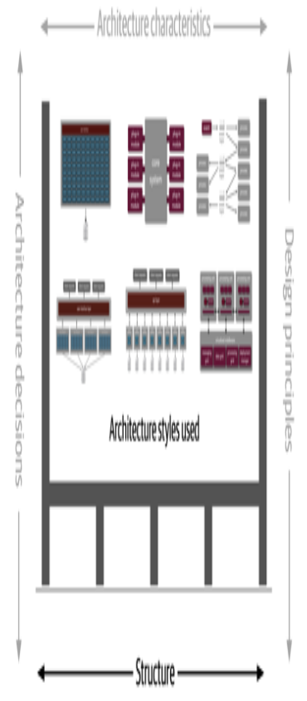

Slide 3
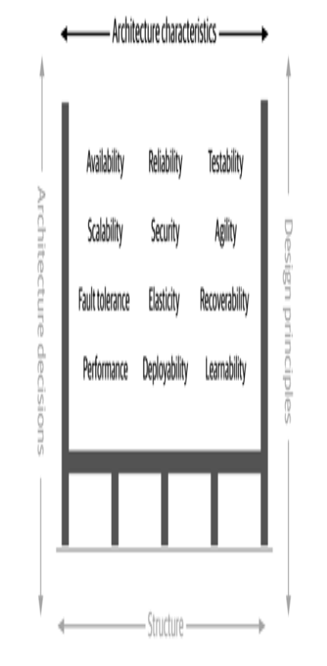

Slide 4
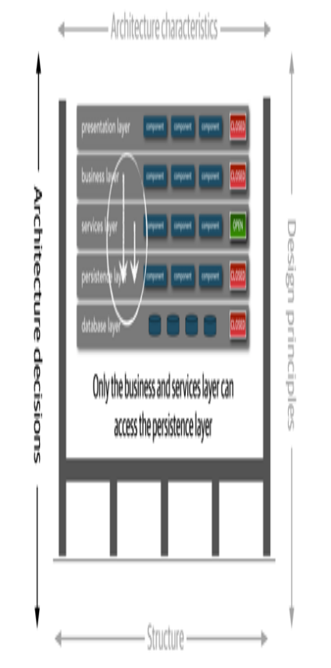

Slide 5
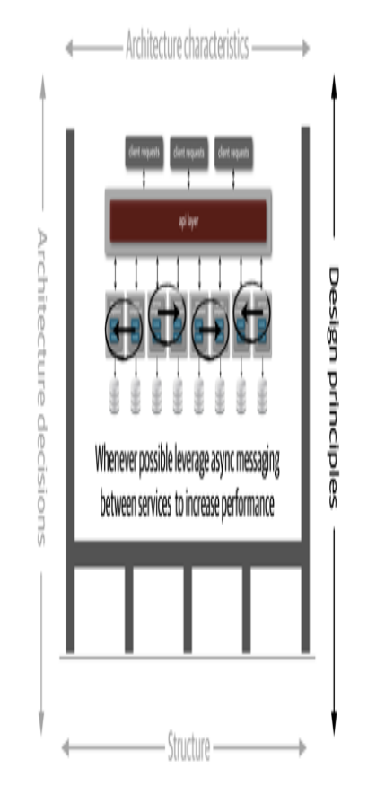

Slide 6
Everything in software architecture is a trade-off
First Law of Software Architecture
If an architect thinks they have discovered something that isn’t a trade-off, more likely they just haven’t identified the trade-off yet.
Corollary 1
Why is more important than how.
Second Law of Software Architecture

Slide 7
